Slide 1
Introduction and Kinematics
Physics
Unit 1
Chapters 1 - 3
Notes:
Physics Unit 1

Slide 2
Credits
This Slideshow was developed to accompany the textbook
  OpenStax Physics
    Available for free at https://openstaxcollege.org/textbooks/college-physics
  By OpenStax College and Rice University
  2013 edition
Some examples and diagrams are taken from the OpenStax Physics and Cutnell & Johnson Physics 6th ed.
Slides created by
Richard Wright, Andrews Academy
rwright@andrews.edu

Slide 3
01-01 Introduction, Units, and Uncertainty
In this lesson you will…
• Explain the difference between a principle and a law.
• Explain the difference between a model and a theory.
• Perform unit conversions both in the SI and English units.
• Explain the most common prefixes in the SI units and be able to write them in scientific notation.
• Determine the appropriate number of significant figures in both addition and subtraction, as well as multiplication and
division calculations.
• Calculate the percent uncertainty of a measurement.

Slide 4
01-01 Introduction, Units, and Uncertainty
Physics is the study of the rules (usually stated mathematically) by which the physical world operates.
These rules describe “how” things happen. Laws of Nature
These rules don’t say “why” things happen. Physicists are most interested in being able to predict what will happen. Many physicists think that because they can say how things happen, they have answered the why.
Why does gravity pull things together? Newton described the effects over 100 years before anyone asked why gravity happened. Einstein suggested that mass bends space-time, but that is just a model.
Physics deals with “how”. “Why” is philosophy.

Slide 5
01-01 Introduction, Units, and Uncertainty
I believe God created the laws of physics.
Since He made the laws, He can stop the effects of those laws when He chooses. This is called a miracle.
Many scientists think that because they can describe nature so well without using God that it proves God does not exist.
I believe being able to describe these intricate, interrelated laws shows the wisdom and might of God. It allows for miracles.
God’s laws of nature don’t change, neither do His other laws like, “Treat other how you would like to be treated” or the 10 Commandments. Following His laws makes everything work better.

Slide 6
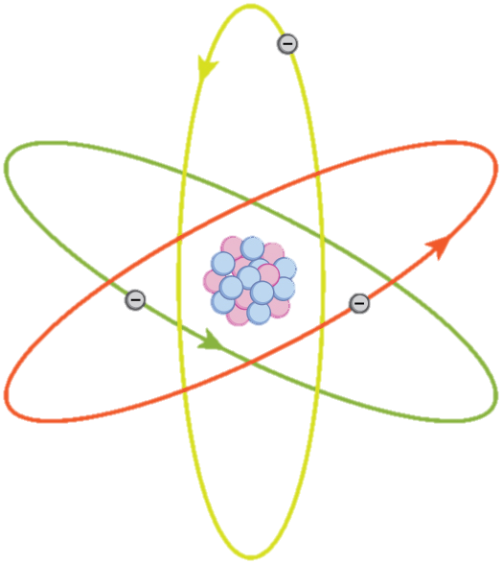
01-01 Introduction, Units, and Uncertainty
Model, Theory, Law
  Model
    A representation of something that is often too difficult (or impossible) to display directly.
    It is only accurate under limited situations.
  Theory
    an explanation for patterns in nature that is supported by scientific evidence and verified multiple times by various groups of researchers.
  Law
    Uses concise language to describe a generalized pattern in nature that is supported by scientific evidence and repeated experiments.
    Often, a law can be expressed in the form of a single mathematical equation.
Notes:
The models, theories, and laws we devise sometimes imply the existence of objects or phenomena as yet unobserved.
However, if experiment does not verify our predictions, then the theory or law is wrong, no matter how elegant or convenient it is.

Slide 7
01-01 Introduction, Units, and Uncertainty
Scientific Method
Can be used to solve many types of problems, not just science
  Usually begins with observation and question about the phenomenon to be studied
  Next preliminary research is done and hypothesis is developed
  Then experiments are performed to test the hypothesis
  Finally the tests are analyzed and a conclusion is drawn

Slide 8
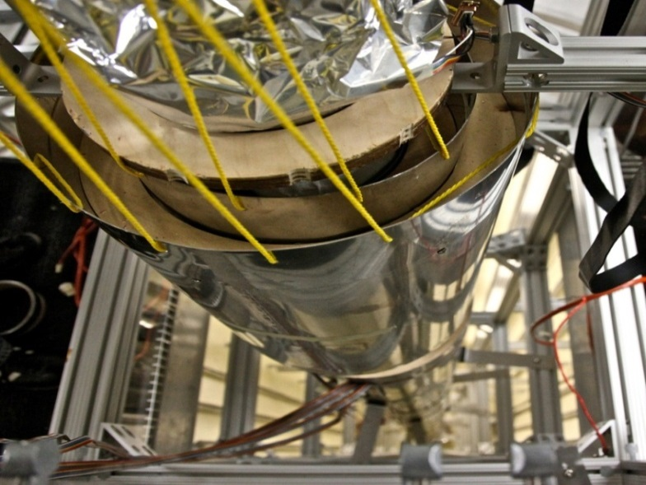
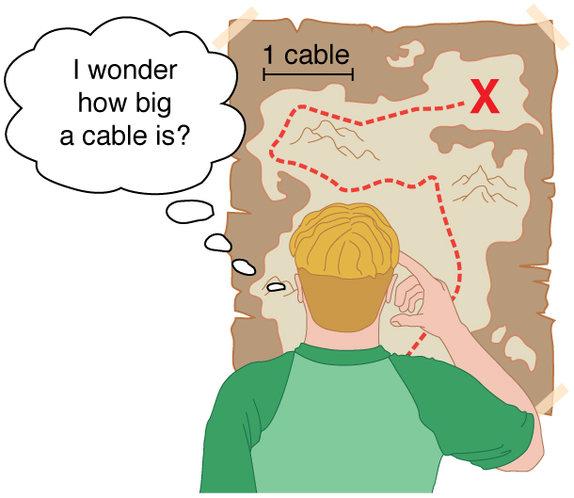
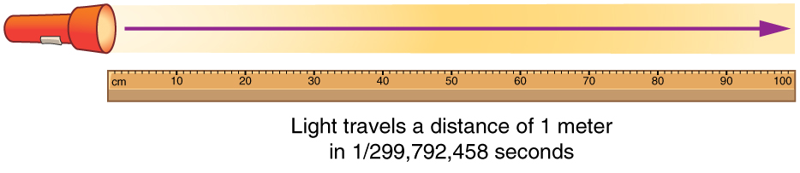
01-01 Introduction, Units, and Uncertainty
Units
  USA uses English system as was used by the British Empire
  Rest of world uses SI system (International System or Metric System)
Fundamental Units - Can only be defined by procedure to measure them
  Time = second (s)
  Distance = meter (m)
  Mass = kilogram (kg)
  Electric Current = ampere (A)
All other units are derived from these 4
Notes:
Meter based on distance light travels in a vacuum in 1/299,792,458 of a second
Second based on time it takes for 9,192,631,770 vibrations of Cesium atoms
Mass based on mass of a platinum-iridium cylinder kept with the old meter standard at the International Bureau of Weights and Measures near Paris

Slide 9
01-01 Introduction, Units, and Uncertainty
Metric Prefixes
  SI system based on powers of ten
  Memorize from T to p
Prefix | Symbol | Value | Prefix | Symbol | Value
exa | E | 10¹⁸ | deci | d | 10⁻¹
peta | P | 10¹⁵ | centi | c | 10⁻²
tera | T | 10¹² | milli | m | 10⁻³
giga | G | 10⁹ | micro | μ | 10⁻⁶
mega | M | 10⁶ | nano | n | 10⁻⁹
kilo | k | 10³ | pico | p | 10⁻¹²
hecto | h | 10² | femto | f | 10⁻¹⁵
decka | da | 10¹ | atto | a | 10⁻¹⁸

Slide 10

01-01 Introduction, Units, and Uncertainty
Unit conversions
Multiply by conversion factors so that the unwanted unit cancels out
Convert 20 Gm to m
  $\frac{20 Gm}{}⋅\left(\frac{1×{10}^{9} m}{1 Gm}\right)$
  $2×{10}^{10} m$

Slide 11

01-01 Introduction, Units, and Uncertainty
Convert 5 cg to kg
  $\frac{5 cg}{}⋅\left(\frac{1×{10}^{−2} g}{1 cg}\right)⋅\left(\frac{1 kg}{1×{10}^{3} g}\right)$
  $\frac{5×{10}^{−2} kg}{1×{10}^{3}}$
  $5×{10}^{−5} kg$

Slide 12

01-01 Introduction, Units, and Uncertainty
Convert 25 km/h to m/s
  $\frac{25 km}{1 h}⋅\left(\frac{1×{10}^{3} m}{1 km}\right)⋅\left(\frac{1 h}{60 min}\right)⋅\left(\frac{1 min}{60 s}\right)$
  $\frac{2.5×{10}^{4} m}{3600 s}$
  $6.94 m/s$

Slide 13
01-01 Introduction, Units, and Uncertainty
Accuracy is how close a measurement is to the correct value for that measurement.
Precision of a measurement system is refers to how close the agreement is between repeated measurements.

Slide 14
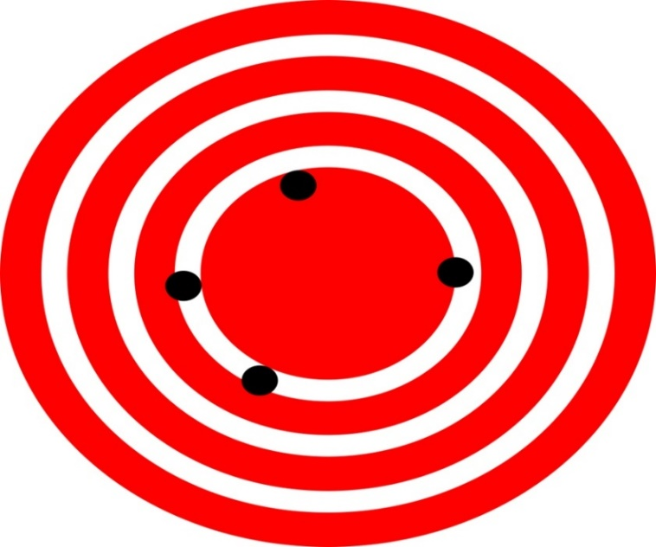

01-01 Introduction, Units, and Uncertainty
Accurate but not precise
Precise but not accurate

Slide 15
01-01 Introduction, Units, and Uncertainty
The accuracy and precision of a measuring system leads to uncertainty.
A device can repeated get the same measurement (precise), but always be wrong (not accurate).

Slide 16
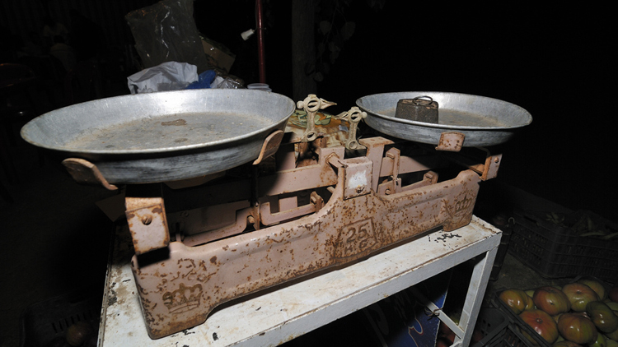
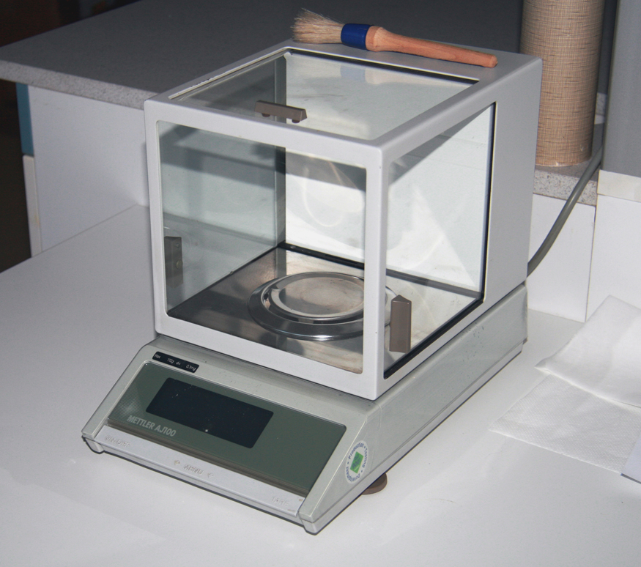
01-01 Introduction, Units, and Uncertainty
Significant Figures
  Used to reflect uncertainty in measurements
Each measuring device can only measure so accurately
The last digit is always an estimate

Slide 17
01-01 Introduction, Units, and Uncertainty
To find significant figures
  Ignore placeholder zeros between the decimal point and the first nonzero digit
  Count the number of other digits
0.000000602
  3 sig figs
1032000
  4 sig figs
1.023
  4 sig figs

Slide 18

01-01 Introduction, Units, and Uncertainty
Rules for combining significant figures
  Addition or subtraction
    The answer can contain no more decimal places than the least precise measurement.
    $1.02 + 2.0223 = 3.04$
  Multiplication or division
    The result should have the same number of significant figures as the quantity having the least significant figures entering into the calculation.
    $1.002⋅2.0223=2.026$
I will accept 3 significant figures for all problems in future assignments.

Slide 19
01-01 Homework
Strive for both precision and accuracy on these problems
Read 2.1, 2.2

Slide 20
01-02 Displacement and Vectors
In this lesson you will…
• Define position, displacement, distance, and distance traveled.
• Explain the relationship between position and displacement.
• Distinguish between displacement and distance traveled.
• Calculate displacement and distance given initial position, final position, and the path between the two.
• Define and distinguish between scalar and vector quantities.
• Assign a coordinate system for a scenario involving one-dimensional motion.

Slide 21

01-02 Displacement and Vectors
Objectives
  Use a ruler to measure in cm.
Materials
  Metric Ruler
  3x5 Card
Background
  The last digit on a measurement is always an estimate. When measuring using a ruler or meter stick, you can estimate between the smallest marks.
What unit are the smallest marks on the metric side of the ruler/meter stick?
If you are measuring in cm, how many decimal places can you measure including the estimate between the smallest marks?
If the smallest marks on the ruler were cm, then what unit would you be estimating?
Measure the shortest side of a 3x5 card.
Measure the longest side of a 3x5 card.
Measure a diagonal of a 3x5 card.
Use the Pythagorean Theorem with the short and long sides to calculate the diagonal to the correct number of significant figures.
Calculate the percent error using
$\%error=\frac{experimental−theoretical}{theoretical}⋅100\%$
The percent error should be less than 5%.

Slide 22
01-02 Displacement and Vectors
Kinematics studies motion without thinking about its cause
Position
  The location where something is relative to a coordinate system called a frame of reference
Position is relative to a reference frame
  Earth is the most common reference frame, but it could be something else
Most common coordinate system is x-y coordinate system

Slide 23
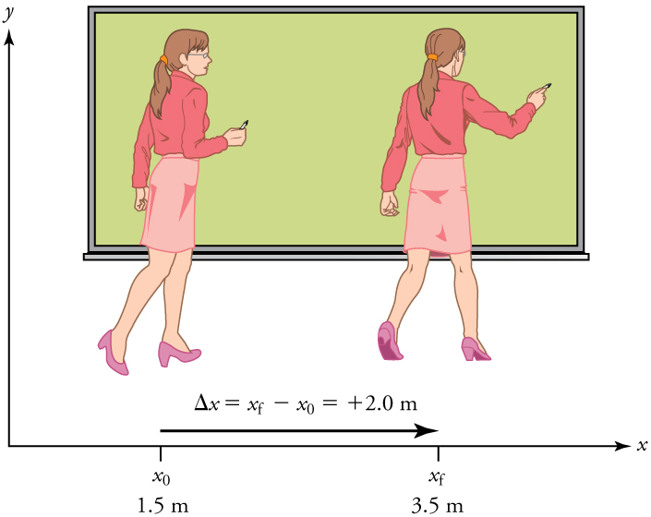

01-02 Displacement and Vectors
Displacement
  Change in position relative to a reference frame
  $Δx=x_{f}−x_{0}$
  Vector
    Has direction and magnitude
  Path does not matter
  Only depends on final and initial position

Slide 24

01-02 Displacement and Vectors
What is the displacement of the path in the diagram?
Notes:
$$Δx=x−x_{0}$$
$$Δx=7−\left(−5\right)=12$$

Slide 25
01-02 Displacement and Vectors
Distance
  Total length of the path taken
  Scalar
    Only has magnitude

Slide 26
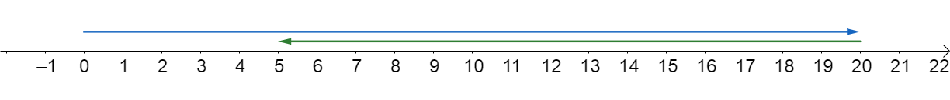


01-02 Displacement and Vectors
You drive 20 km east, then turn around and drive 15 km west. What is your displacement?
  $Δx=x−x_{0}$
  $Δx=5 km−0 km$
  $5 km$
  5 km east of your starting point
What is your distance traveled?
  $20 km+15 km$
  $35 km$

Slide 27
01-02 Homework
Displace some lead on your paper
Read 2.3, 2.8

Slide 28
01-03 Velocity and Graphs
In this lesson you will…
• Explain the relationships between instantaneous velocity, average velocity, instantaneous speed, average speed,
displacement, and time.
• Calculate velocity and speed given initial position, initial time, final position, and final time.
• Derive a graph of velocity vs. time given a graph of position vs. time.
• Interpret a graph of velocity vs. time.
• Describe a straight-line graph in terms of its slope and y-intercept.
• Determine average velocity or instantaneous velocity from a graph of position vs. time.
• Derive a graph of velocity vs. time from a graph of position vs. time.

Slide 29

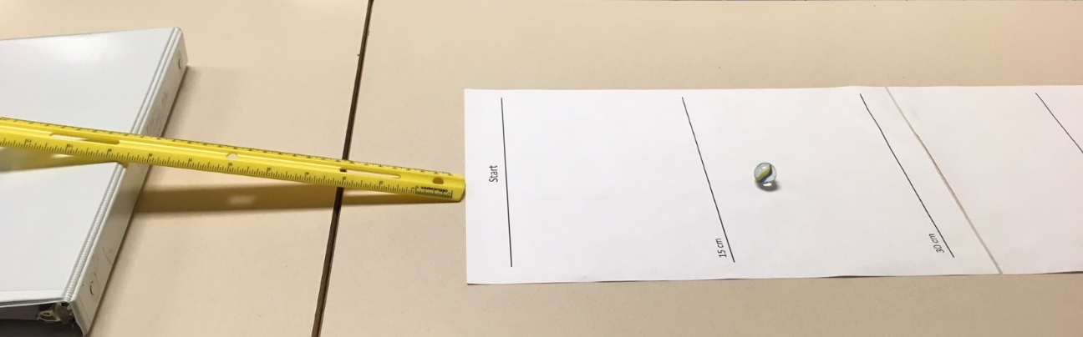

01-03 Velocity and Graphs
Complete the lab on your worksheet
Vernier Graphical App
  New Experiment
  Manual Entry
  Horizontal in X column
  Vertical in Y column
  Button in lower left
    Apply Curve Fit
    Choose the type of fit

Slide 30

01-03 Velocity and Graphs
Change in time
  $Δt=t_{f}−t_{0}$
Often $t_{0}$ is 0, so $Δt=t_{f}=t$

Slide 31
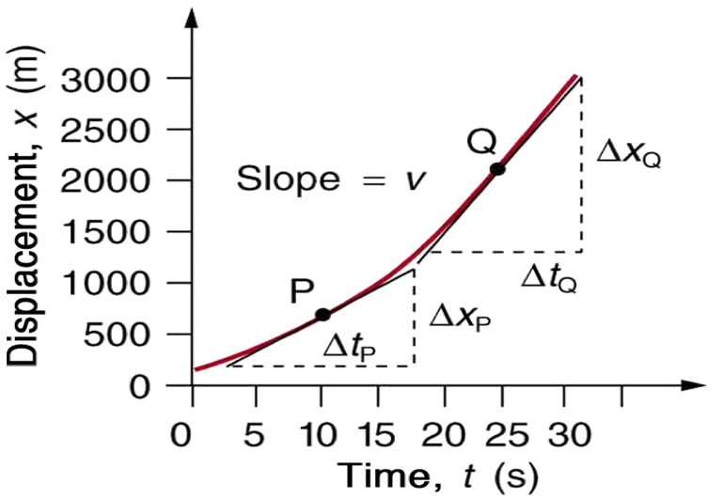

01-03 Velocity and Graphs
The slope of a position vs time graph is the velocity
Velocity is rate of change of position
$$\overline{v}=\frac{x−x_{0}}{t−t_{0}}$$
$$x=\overline{v}t+x_{0}$$
If the graph is not a straight line, then use the slope of a tangent line drawn to that point.

Slide 32

01-03 Velocity and Graphs
Velocity is a vector (has direction) $v=\frac{displacement}{time}$
Speed is a scalar (no direction) $v=\frac{distance}{time}$
Units of both are m/s

Slide 33
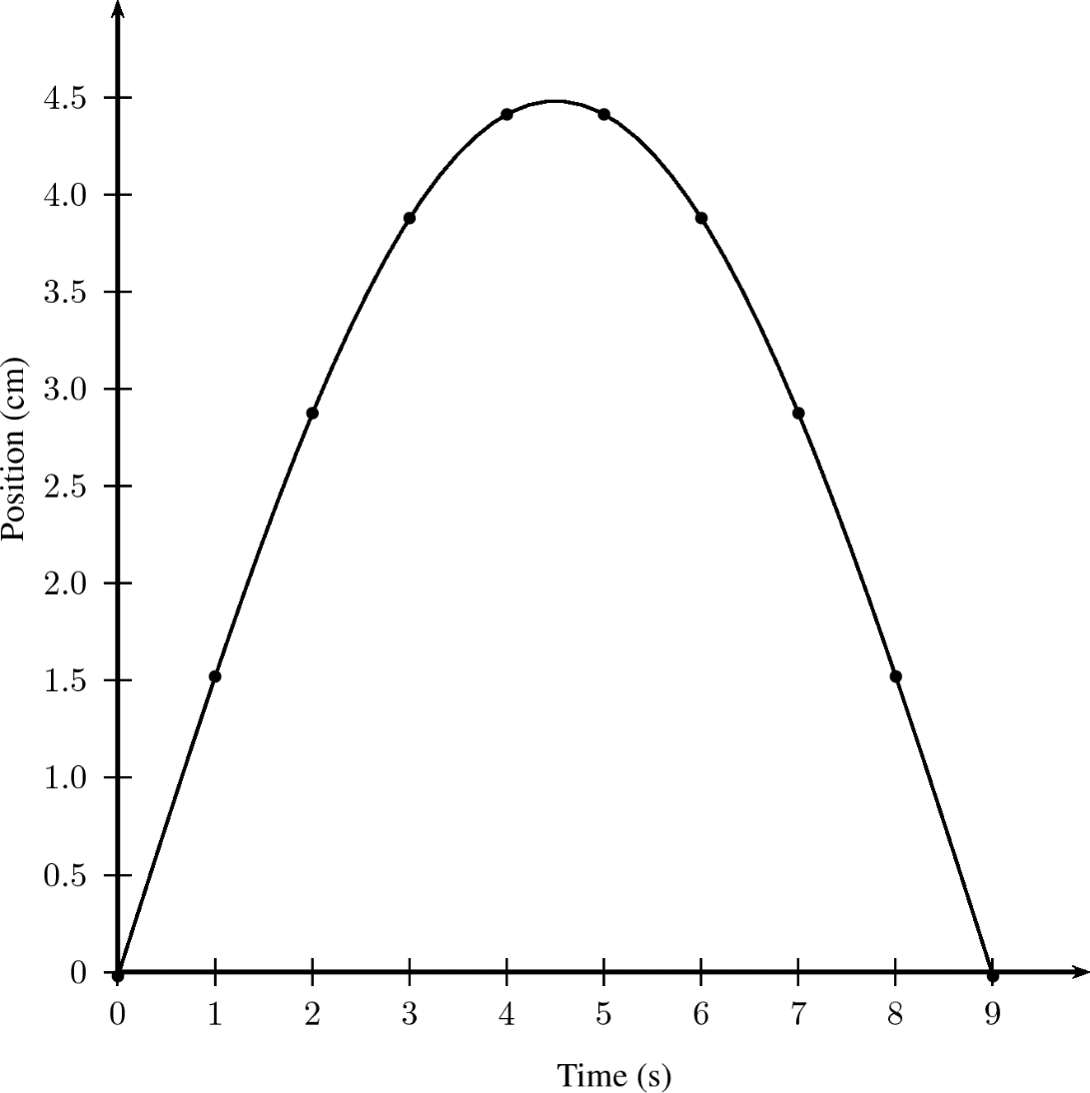

01-03 Velocity and Graphs
The graph at right shows the height of a ball thrown straight up vs time. Find the velocity of the ball at 2 seconds.
$v=\frac{x−x_{0}}{t−t_{0}}$
$v=\frac{4.2 cm−1.7 cm}{3 s−1 s}$
$v=\frac{2.5 cm}{2 s}=1.3\frac{cm}{s}$
4.2
1.7

Slide 34
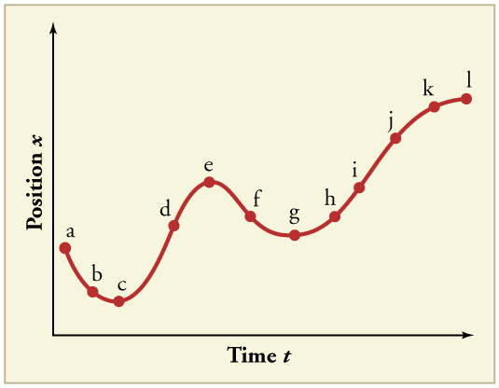
01-03 Velocity and Graphs
27. (a) Sketch a graph of velocity versus time corresponding to the graph of displacement versus time given in the graph. (b) Identify the time or times (t_{a}, t_{b}, t_{c}, etc.) at which the instantaneous velocity is greatest. (c) At which times is it zero? (d) At which times is it negative?
Notes:
Find the slopes by drawing tangent lines, sketch graph based on these values
d
c,e,g,l
a,b,f

Slide 35
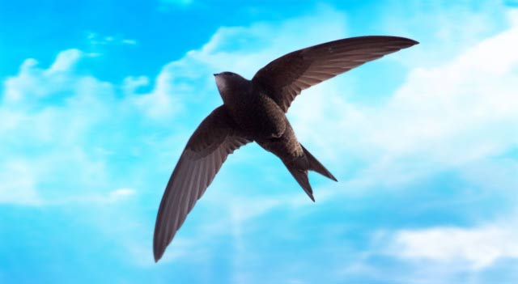

01-03 Velocity and Graphs
The spine-tailed swift is the fastest bird in powered flight. On one flight a particular bird flies 306 m east, then turns around and flies 406.5 m back west. This flight takes 15 s. What is the bird’s average velocity?
  $\overline{v}=\frac{Δx}{Δt}=\frac{306 m−406.5 m}{15 s}=−6.7 m/s$
  6.7 m/s west
Average speed?
  $v=\frac{distance}{time}$
  $v=\frac{\left(306 m+406.5 m\right)}{15 s}=47.5\frac{m}{s}$
Which of these would we use to say how fast the bird is?
  Average speed

Slide 36
01-03 Homework
Time is important, work efficiently
Read 2.4, 2.8

Slide 37
01-04 Acceleration and Graphs
In this lesson you will…
• Define and distinguish between instantaneous acceleration, average acceleration, and deceleration.
• Calculate acceleration given initial time, initial velocity, final time, and final velocity.
• Determine average or instantaneous acceleration from a graph of velocity vs. time.
• Derive a graph of acceleration vs. time from a graph of velocity vs. time.

Slide 38
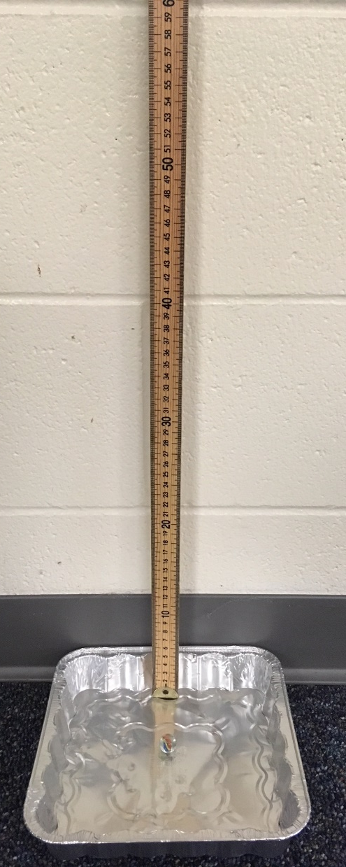
01-04 Acceleration and Graphs
Complete the lab on your worksheet

Slide 39
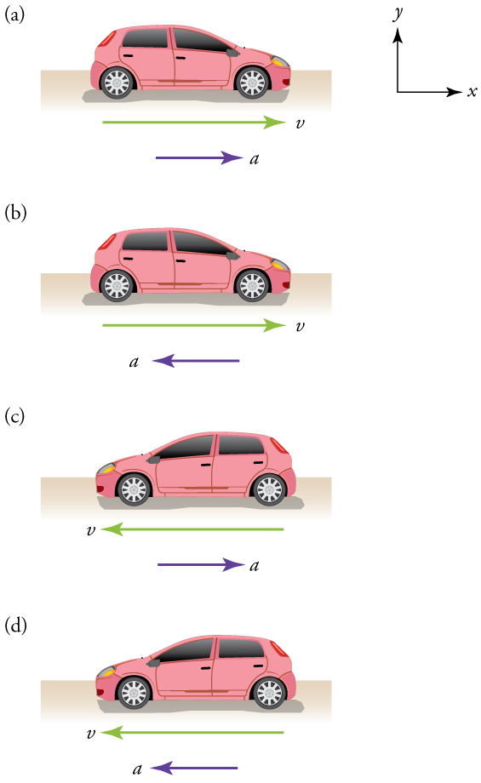

01-04 Acceleration and Graphs
Acceleration
  Rate of change of velocity
  $$\overline{a}=\frac{Δv}{Δt}=\frac{v_{f}−v_{0}}{t_{f}−t_{0}}$$
$$v=at+v_{0}$$
Vector
Unit: $m/s^{2}$
If the acceleration is same direction as motion, then the object is increasing speed.
If the acceleration is opposite direction as motion, then the object is decreasing speed.
Notes:
Speeding up
Slowing
Slowing
Speeding up

Slide 40
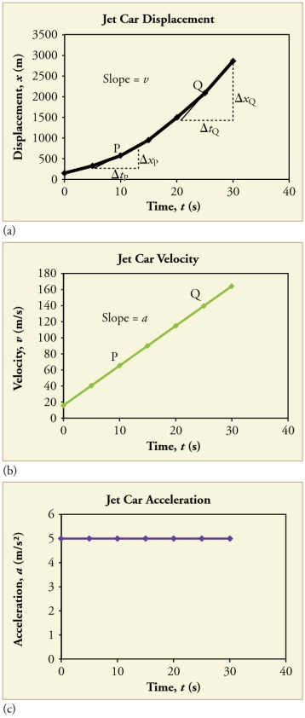

01-04 Acceleration and Graphs
Constant acceleration
  The graph of position–time is parabolic
    ($x=\frac{1}{2}at^{2}+v_{0}t+x_{0}$ is quadratic)
  The graph of velocity–time is linear
    ($v=at+v_{0}$ is linear)

Slide 41

01-04 Acceleration and Graphs
A dropped object near the earth will accelerate downward at 9.8 m/s². (Use -9.8 m/s².) If the initial velocity is 1 m/s downward, what will be it’s velocity at the end of 3 s? Is it speeding up or slowing down?
$a=\frac{v_{f}−v_{0}}{t_{f}−t_{0}}$
$−9.8\frac{m}{s^{2}}=\frac{v_{f}−\left(−1\frac{m}{s}\right)}{3 s}$
$−29.4\frac{m}{s}=v_{f}+1\frac{m}{s}$
$−30.4\frac{m}{s}=v_{f}$
30.4 m/s downward

Slide 42
01-04 Homework
Analyze this…
Read 2.5-2.6

Slide 43
01-05 Equations for One-Dimensional Motion with Constant Acceleration
In this lesson you will…
• Calculate displacement of an object that is not accelerating, given initial position and velocity.
• Calculate final velocity of an accelerating object, given initial velocity, acceleration, and time.
• Calculate displacement and final position of an accelerating object, given initial position, initial velocity, time, and
acceleration.
• Apply problem-solving steps and strategies to solve problems of one-dimensional kinematics.
• Apply strategies to determine whether or not the result of a problem is reasonable, and if not, determine the cause.

Slide 44
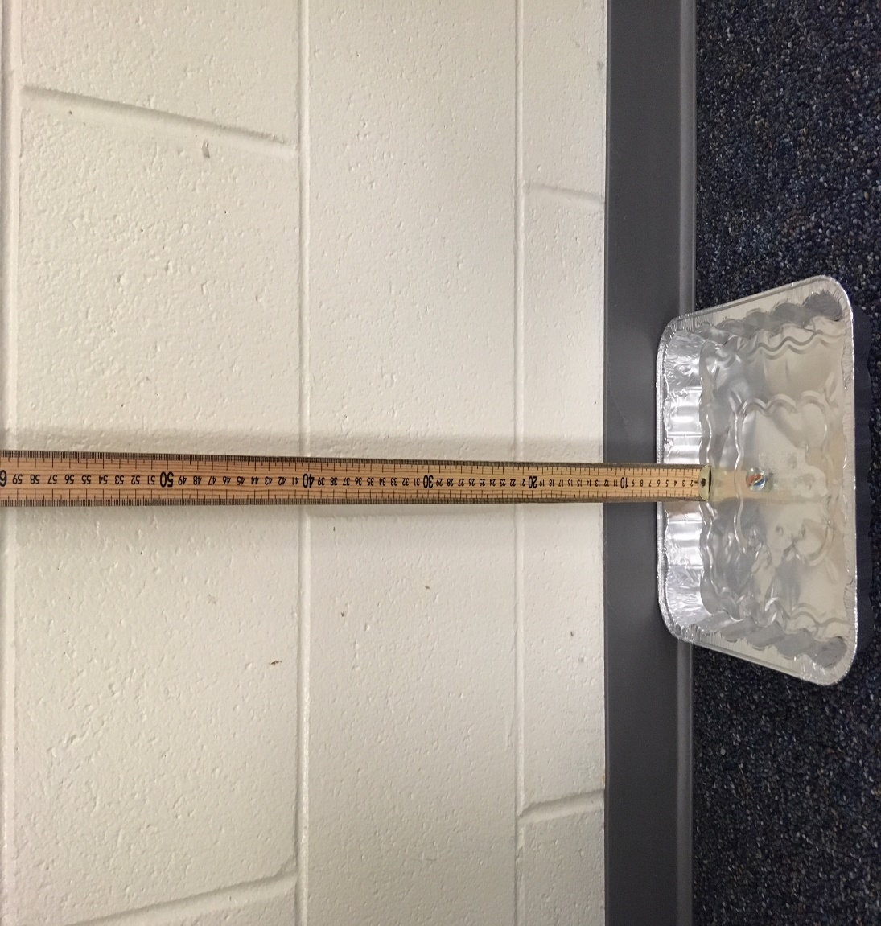

01-05 Equations for One-Dimensional Motion with Constant Acceleration
Complete the lab on your worksheet
We have already learned that
$$\overline{v}=\frac{Δx}{Δt}$$
and
$$\overline{v}=\frac{v_{f}+v_{0}}{2}$$
If the initial velocity is 0 and the acceleration is constant, then
$$\overline{v}=\frac{v_{f}}{2}$$
Solve this for v_{f}.

Slide 45

01-05 Equations for One-Dimensional Motion with Constant Acceleration
Assume $t_{0}=0$, so $Δt=t$ and acceleration is constant
$\overline{v}=\frac{x−x_{0}}{t}$
$x=\overline{v}t+x_{0}$ and $\overline{v}=\frac{v_{0}+v}{2}$
$x=\frac{1}{2}\left(v_{0}+v\right)t+x_{0}$

Slide 46

01-05 Equations for One-Dimensional Motion with Constant Acceleration
$a=\frac{v−v_{0}}{t}$
$v−v_{0}=at$
$v=at+v_{0}$

Slide 47

01-05 Equations for One-Dimensional Motion with Constant Acceleration
$v=at+v_{0}$
$v_{0}+v=at+2v_{0}$
$\frac{v_{0}+v}{2}=\frac{1}{2}at+v_{0}$
$\overline{v}=\frac{1}{2}at+v_{0}$
$x=\overline{v}t+x_{0}$
$x=\left(\frac{1}{2}at+v_{0}\right)t+x_{0}$
$x=\frac{1}{2}at^{2}+v_{0}t+x_{0}$

Slide 48

01-05 Equations for One-Dimensional Motion with Constant Acceleration
$v=at+v_{0}$
$t=\frac{v−v_{0}}{a}$
$\overline{v}=\frac{v_{0}+v}{2}$
$x=\overline{v}t+x_{0}$
$x=\left(\frac{v_{0}+v}{2}\right)\left(\frac{v−v_{0}}{a}\right)+x_{0}$
$x−x_{0}=\left(\frac{v^{2}−v_{0}^{2}}{2a}\right)$
$2a\left(x−x_{0}\right)=v^{2}−v_{0}^{2}$
$v^{2}=v_{0}^{2}+2a(x−x_{0})$

Slide 49

01-05 Equations for One-Dimensional Motion with Constant Acceleration
$$x=\overline{v}t+x_{0}$$
$$\overline{v}=\frac{v_{0}+v}{2}$$
$$v=at+v_{0}$$
$$x=\frac{1}{2}at^{2}+v_{0}t+x_{0}$$
$$v^{2}=v_{0}^{2}+2a(x−x_{0})$$

Slide 50
01-05 Equations for One-Dimensional Motion with Constant Acceleration
Examine the situation to determine which physical principles are involved.
  Maybe draw a picture
Make a list of what is given or can be inferred from the problem.
Identify exactly what needs to be determined in the problem.
Find an equation or set of equations that can help you solve the problem.
Substitute the knowns along with their units into the appropriate equation, and Solve
Check the answer to see if it is reasonable: Does it make sense?

Slide 51
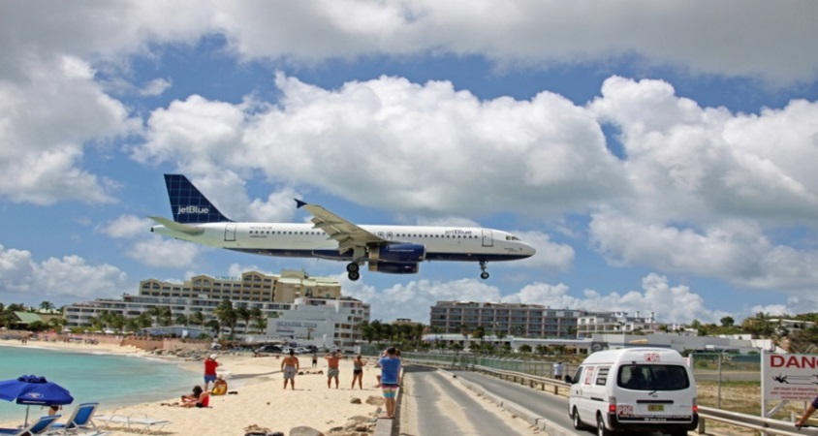

01-05 Equations for One-Dimensional Motion with Constant Acceleration
A plane starting from rest accelerates to $40 m/s$ in $10 s$. How far did the plane travel during this time?
$v=40 m/s, t=10 s, v_{0}=0, x_{0}=0, x= ?$
$\overline{v}=\frac{v_{0}+v}{2}$ → $\overline{v}=\frac{0+40\frac{m}{s}}{2}=20 m/s$
$x=\overline{v}t+x_{0}$
$x=\left(20\frac{m}{s}\right)\left(10 s\right)+0$
$x=200 m$

Slide 52

01-05 Equations for One-Dimensional Motion with Constant Acceleration
  To avoid an accident, a car decelerates at $0.50 m/s^{2}$ for $3.0 s$ and covers $15 m$ of road. What was the car’s initial velocity?
  $a=−0.5 m/s^{2}$, $t=3 s$, $x=15 m$, $x_{0}=0$, $v_{0}= ?$
  $x=\frac{1}{2}at^{2}{+v_{0}t+ x}_{0}$
  $15 m=\frac{1}{2}\left(−0.5\frac{m}{s^{2}}\right){\left(3 s\right)}^{2}+v_{0}\left(3 s\right)+0$
  $15 m=−2.25 m+v_{0}\left(3 s\right)$
  $17.25 m=v_{0}\left(3 s\right)$
  $v_{0}=5.75 m/s$

Slide 53


01-05 Equations for One-Dimensional Motion with Constant Acceleration
A cheetah is walking at 1.0 m/s when it sees a zebra 25 m away. What acceleration would be required to reach 20.0 m/s in that distance?
$v=20.0\frac{m}{s}, v_{0}=1.0\frac{m}{s}, x=25 m, x_{0}=0, a= ?$
$v^{2}=v_{0}^{2}+2a\left(x−x_{0}\right)$
${\left(20\frac{m}{s}\right)}^{2}={\left(1.0\frac{m}{s}\right)}^{2}+2a\left(25 m−0\right)$
$400\frac{m^{2}}{s^{2}}=1\frac{m^{2}}{s^{2}}+\left(50 m\right)a$
$399\frac{m^{2}}{s^{2}}=\left(50 m\right)a$
$a=7.98 m/s^{2}$

Slide 54


01-05 Equations for One-Dimensional Motion with Constant Acceleration
The left ventricle of the heart accelerates blood from rest to a velocity of +26 cm/s. (a) If the displacement of the blood during the acceleration is +2.0 cm, determine its acceleration (in cm/s²). (b) How much time does blood take to reach its final velocity?
$v_{0}=0\frac{cm}{s},v=26\frac{cm}{s}, Δx=2 cm, a=?$
$v^{2}=v_{0}^{2}+2a\left(x−x_{0}\right)$
$a=169\frac{cm}{s^{2}}$
$v_{0}=0\frac{cm}{s},v=26\frac{cm}{s}, Δx=2 cm, t=?$
$x=\overline{v}t+x_{0};\overline{v}=\frac{v_{0}+v}{2}$
$t=0.15 s$
Notes:
a) $v^{2}=v_{0}^{2}+2a\left(x−x_{0}\right)$
$${\left(26\frac{cm}{s}\right)}^{2}={\left(0\frac{m}{s}\right)}^{2}+2a\left(2 cm\right)$$
$$676\frac{cm^{2}}{s^{2}}=4a cm$$
$$a=169\frac{cm}{s^{2}}$$
b) $x=x_{0}+\overline{v}t;\overline{v}=\frac{v+v_{0}}{2}$
$$\overline{v}=\frac{0\frac{cm}{s}+26\frac{cm}{s}}{2}=13\frac{cm}{s}$$
$$x=\overline{v}t+x_{0}$$
$$2 cm=\left(13\frac{cm}{s}\right)t$$
$$t=0.15 s$$

Slide 55
01-05 homework
Practice problem solving by solving problems
Read 2.7

Slide 56
01-06 Falling Objects
In this lesson you will…
• Describe the effects of gravity on objects in motion.
• Describe the motion of objects that are in free fall.
• Calculate the position and velocity of objects in free fall.

Slide 57


01-06 Falling Objects
Complete the lab on your worksheet
We have already learned that
$$\overline{v}=\frac{v_{f}+v_{0}}{2}$$
If the initial velocity is 0 and the acceleration is constant, then
$$v_{f}=2\overline{v}$$
Also
$$a=\frac{Δv}{Δt}=\frac{v−v_{0}}{t}$$
Use $\overline{v}=\frac{Δx}{Δt}$to find the average velocity.
Find the final speed of the marble.
So calculate the acceleration of the marble.

Slide 58
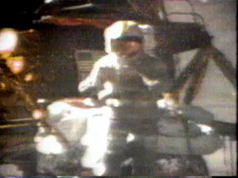

01-06 Falling Objects
Free fall is when an object is moving only under the influence of gravity
In a vacuum all objects fall at same acceleration
$g=9.80\frac{m}{s^{2}}down$
Any object thrown up, down, or dropped has this acceleration

Slide 59
01-06 Falling Objects
Do feather falling demo
Real life
  Air resistance
Use the one-dimensional equations of motion

Slide 60

01-06 Falling Objects
You drop a coin from the top of a hundred story building (1000 m). If you ignore air resistance, how fast will it be falling right before it hits the ground?
$v0=0, v= ?, a=−9.80\frac{m}{s2}, x_{0}=1000 m, x=0 m$
$v2=v02+2a\left(x−x_{0}\right)$
$v2=0+2(−9.80 m/s2)(0−1000 m)$
$v2=19600 m2/s2$
$v=−140 m/s$
Notes:
When solving and taking square root, then use $±$ sign. Took negative here because it was going down.

Slide 61

01-06 Falling Objects
How long does it take to hit the ground?
$x=\frac{1}{2}at2+v0t+x_{0}$
$0 m=\frac{1}{2}\left(−9.80\frac{m}{s2}\right)t2+0\left(t\right)+1000 m$
$−1000 m=−4.90\frac{m}{s2}t2$
$204.1 s2=t2$
$14.3 s=t$

Slide 62

01-06 Falling Objects
A baseball is hit straight up into the air. If the initial velocity was 20 m/s, how high will the ball go?
$v0=20\frac{m}{s}, a=−9.80\frac{m}{s2}, v \left(at top\right)=0, x= ?, x_{0}=0$
$v2=v02+2a\left(x−x_{0}\right)$
$0=\left(20\frac{m}{s}\right)2+2\left(−9.80\frac{m}{s2}\right)\left(x−0\right)$
$−400\frac{m2}{s2}= −19.6\frac{m}{s2}x$
$x=20.4 m$

Slide 63

01-06 Falling Objects
How long will it be until the catcher catches the ball at the same height it was hit?
$v0=20\frac{m}{s}, a=−9.80\frac{m}{s2}, t= ?, x=0, x_{0}=0$
$x=\frac{1}{2}at^{2}+v_{0}t+x_{0}$
$0 m=\frac{1}{2}\left(−9.80\frac{m}{s^{2}}\right)t^{2}+\left(20\frac{m}{s}\right)t+0 m$
$0=t\left(−4.90\frac{m}{s^{2}}t+20\frac{m}{s}\right)$
$t=0 s$ or $−4.90\frac{m}{s^{2}}t+20\frac{m}{s}=0$
$−4.90\frac{m}{s^{2}}t=−20\frac{m}{s}$
$t=4.08 s$

Slide 64

01-06 Falling Objects
How fast is it going when catcher catches it?
$v0=20\frac{m}{s}, a=−9.80\frac{m}{s2}, t= ?, x=0, x_{0}=0$
$v^{2}=v_{0}^{2}+2a(x−x_{0})$
$v^{2}={\left(20\frac{m}{s}\right)}^{2}+2\left(−9.80\frac{m}{s^{2}}\right)\left(0 m −0 m\right)$
$v^{2}={\left(20\frac{m}{s}\right)}^{2}$
$v=±20 m/s$ so $v=−20 m/s$
Notes:
It’s going down.

Slide 65
01-06 Homework
“I’m falling for you…”
Read 3.1-3.3

Slide 66
01-07 Two-Dimensional Vectors
In this lesson you will…
• Observe that motion in two dimensions consists of horizontal and vertical components.
• Understand the independence of horizontal and vertical vectors in two-dimensional motion. • Understand the rules of vector addition, subtraction, and multiplication.
• Apply graphical methods of vector addition and subtraction to determine the displacement of moving objects. • Understand the rules of vector addition and subtraction using analytical methods.
• Apply analytical methods to determine vertical and horizontal component vectors.
• Apply analytical methods to determine the magnitude and direction of a resultant vector.

Slide 67
01-07 Two-Dimensional Vectors
Vectors
Vectors are measurements with magnitude and direction
  They are represented by arrows
  The length of the arrow is the magnitude
  The direction of the arrow is the direction

Slide 68
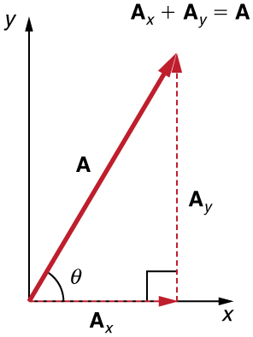

01-07 Two-Dimensional Vectors
Vectors can be represented in component form
  Make a right triangle using the vector as the hypotenuse
  Use sine and cosine to find the horizontal (x) component and the vertical (y) component
  Assign negative signs to any component going down or left
$$\sin\left(θ\right)=\frac{opposite}{hypotenuse} \\ \cos\left(θ\right)=\frac{adjacent}{hypotenuse} \\ \tan\left(θ\right)=\frac{opposite}{adjacent}$$

Slide 69
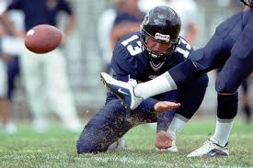

01-07 Two-Dimensional Vectors
A football player kicks a ball at 15 m/s at 30° above the ground. Find the horizontal and vertical components of this velocity.
Horizontal: $v_{x}=15\frac{m}{s} cos\left(30°\right)=13.0\frac{m}{s}$
Vertical: $v_{y}=15\frac{m}{s} sin\left(30°\right)=7.5\frac{m}{s}$

Slide 70
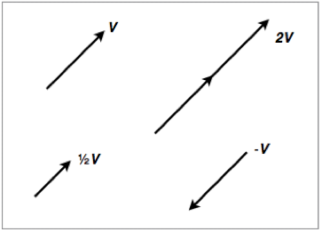
01-07 Two-Dimensional Vectors
Scalar Multiplication
Multiplying a vector by a single number
Draw the vector that many times in a line
Or multiply the components by that number
A negative vector means multiply by -1, so it goes in the opposite direction

Slide 71
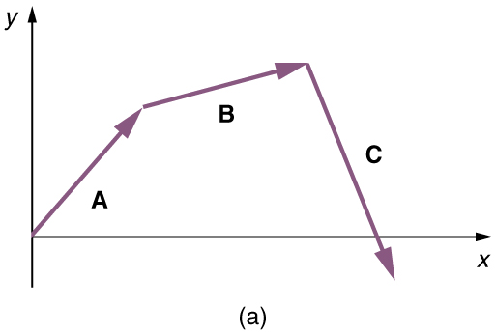
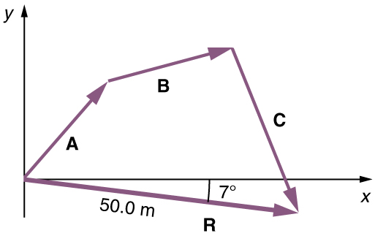
01-07 Two-Dimensional Vectors
Vector Addition - Graphical Method
Draw the first vector.
Draw the second vector where the first one ends (tip-to-tail).
Draw the resultant vector from where the first vector begins to where the second vector ends.
Measure the resultant's length and direction.

Slide 72

01-07 Two-Dimensional Vectors
Add the following vectors graphically. $A=2\sqrt{2}$ at 45° N of E, $B=2\sqrt{2}$ at 45° W of N.

Slide 73
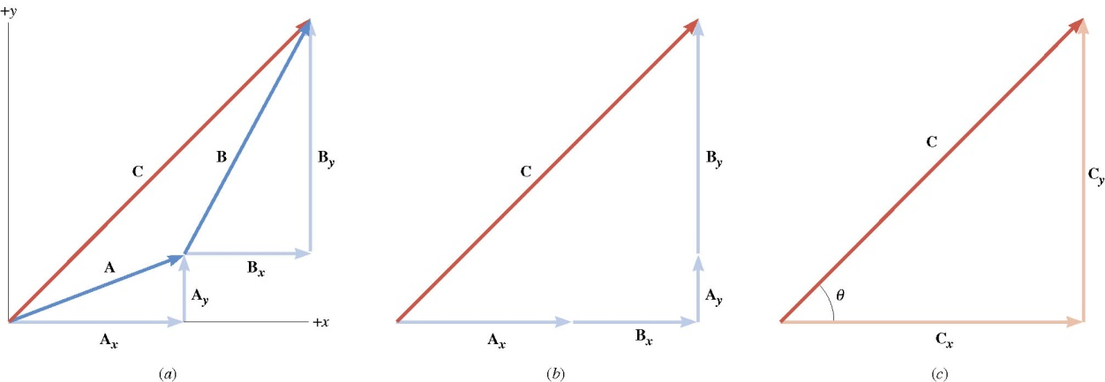
01-07 Two-Dimensional Vectors
Vector Addition – Component Method
Vectors can be described by its components to show how far it goes in the x and y directions.
To add vectors, you simply add the x-component and y-components to get total (resultant) x and y components.
Find the components for all the vectors to be added
Add all the x-components
Add all the y-components
Use the Pythagorean Theorem to find the magnitude of the resultant
Use tan⁻¹ to find the direction (the direction is always found at the tail-end of the resultant)
Note: Drawing pictures and triangles helps immensely.

Slide 74
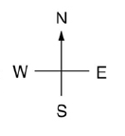


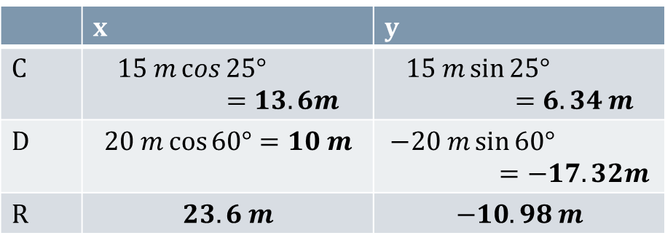
01-07 Two-Dimensional Vectors
Add the follow vectors.
$C=15 m$ at 25° N of E;
$D=20 m$ at 60° S of E
 | x | y
C | $$15 m\cos{25°}=13.6m$$ | $$15 m\sin{25°}=6.34 m$$
D | $$20 m\cos{60°}=10 m$$ | $$−20 m\sin{60°}=−17.32m$$
R | $$23.6 m$$ | $$−10.98 m$$
$R=\sqrt{{\left(23.6 m\right)}^{2}+{\left(−10.98 m\right)}^{2}}=26.0 m$
$θ=\tan^{−1}{\frac{10.98 m}{23.6 m}}=25.0° S of E$
C
D
R

Slide 75
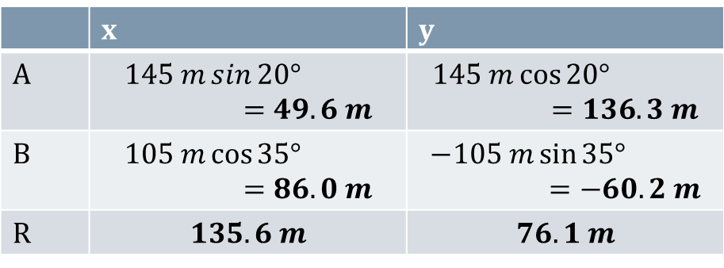

01-07 Two-Dimensional Vectors
A jogger runs 145 m in a direction 20.0° east of north and then 105 m in a direction 35.0° south of east. Determine the magnitude and direction of jogger's position from her starting point.
 | x | y
A | $$145 m\sin{20°}=49.6 m$$ | $$145 m\cos{20°}=136.3 m$$
B | $$105 m\cos{35°}=86.0 m$$ | $$−105 m\sin{35°}=−60.2 m$$
R | $$135.6 m$$ | $$76.1 m$$
$R=\sqrt{{\left(135.6 m\right)}^{2}+{\left(76.1m\right)}^{2}}=155.5 m$
$θ=\tan^{−1}{\frac{76.1 m}{135.6 m}}=29.3° N of E$
B
A
R

Slide 76
01-07 Homework
Let’s add some arrows
Read 3.4

Slide 77
01-08 Projectile Motion
In this lesson you will…
• Identify and explain the properties of a projectile, such as acceleration due to gravity, range, maximum height, and
trajectory.
• Determine the location and velocity of a projectile at different points in its trajectory.
• Apply the principle of independence of motion to solve projectile motion problems.

Slide 78
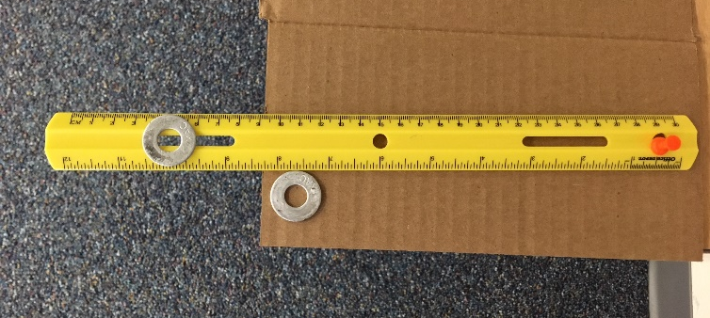
01-08 Projectile Motion
Complete the lab on your worksheet.
Use a pushpin to attach one end of the ruler into the corkboard so the end hangs over the corkboard. The ruler should be able to pivot on the pushpin.
Place one washer on the ruler so that it hangs over the edge of the corkboard. The other washer should be placed near the edge of the corkboard.
Notes:
Note at highest point, vy = 0

Slide 79
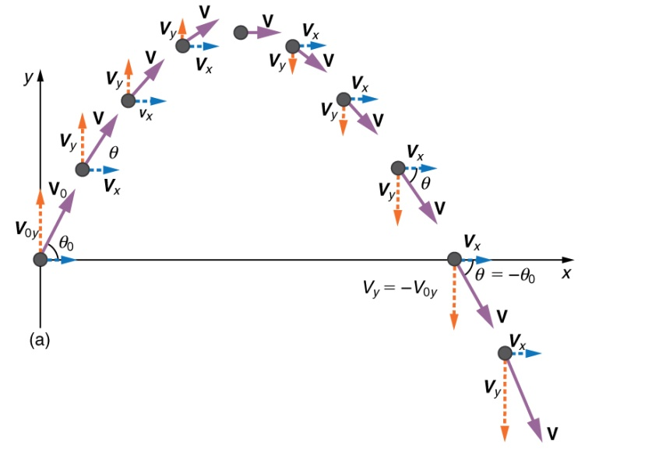

01-08 Projectile Motion
Objects in flight only under influence of gravity
x and y components are independent
  Time is only quantity that is the same in both dimensions
x-component velocity constant since nothing pulling it sideways
  Use $x=v_{0}t$
y-component changes because gravity pulling it down
  Use equations of kinematics
Notes:
Note at highest point, vy = 0

Slide 80

01-08 Projectile Motion
If the starting and ending heights are the same, the distance the object goes can be found with the range equation
$$r=\frac{v_{0}^{2}\sin{2θ}}{g}$$

Slide 81


01-08 Projectile Motion
A meatball with v = 5.0 m/s rolls off a 1.0 m high table. How long does it take to hit the floor?
y-motion only
$v_{0y}=0\frac{m}{s}, y_{0}=1.0 m,$
$y=0 m, a_{y}=−9.8\frac{m}{s^{2}}, t= ?$
$y=\frac{1}{2}a_{y}t^{2}{+v_{0y}t+ y}_{0}$
$0 m=\frac{1}{2}\left(−9.8\frac{m}{s^{2}}\right)t^{2}+0\frac{m}{s}t+1.0 m$
$−1.0 m=−4.9\frac{m}{s^{2}}t^{2}$
$0.20 s^{2}=t^{2}$
$0.45 s=t$

Slide 82




01-08 Projectile Motion
What was the velocity when it hit?
Both x and y motion
x: $v_{0x}=5.0\frac{m}{s}, t=0.45 s$
y: $v_{0y}=0\frac{m}{s}, y_{0}=1.0 m,$
$y=0 m, a_{y}=−9.8\frac{m}{s^{2}},$
$t=0.45 s$
x-direction
$v_{x}=5.0\frac{m}{s}$
y-direction
$v_{y}=a_{y}t+v_{0y}$
$v_{y}=−9.8\frac{m}{s^{2}}\left(0.45 s\right)+0\frac{m}{s}$
$v_{y}=−4.4\frac{m}{s}$
$v_{R}=\sqrt{{\left(5.0\frac{m}{s}\right)}^{2}+{\left(−4.4\frac{m}{s}\right)}^{2}}=6.7\frac{m}{s}$
$θ=\tan^{−1}{\frac{−4.4\frac{m}{s}}{5.0\frac{m}{s}}}=−42°$
$$6.7\frac{m}{s} at 42° below horizontal$$
Notes:
X-velocity doesn’t change since no acceleration in x

Slide 83


01-08 Projectile Motion
A truck (v = 11.2 m/s) turned a corner too sharp and lost part of the load. A falling box will break if it hits the ground with a velocity greater than 15 m/s. The height of the truck bed is 1.5 m. Will the box break?
x: $v_{0x}=11.2\frac{m}{s}, v_{x}=11.2\frac{m}{s}$
y: $v_{0y}=0\frac{m}{s}, y_{0}=1.5 m, y=0 m, a_{y}=−9.8\frac{m}{s^{2}}, v_{y}= ?$
y-direction:
$v_{y}^{2}=v_{0y}^{2}+2a_{y}(y−y_{0})$
$v_{y}^{2}={\left(0\frac{m}{s}\right)}^{2}+2\left(−9.8\frac{m}{s^{2}}\right)\left(0−1.5 m\right)$
$v_{y}^{2}=29.4\frac{m^{2}}{s^{2}}$
$v_{y}=−5.42 m/s$
$v_{R}=\sqrt{{\left(11.2\frac{m}{s}\right)}^{2}+{\left(−5.42\frac{m}{s}\right)}^{2}}$
$v_{R}=12.4 m/s$ The box doesn’t break

Slide 84
01-08 Projectile Motion
While driving down a road a bad guy shoots a bullet straight up into the air. If there was no air resistance where would the bullet land – in front, behind, or on him?
If air resistance present, bullet slows and lands behind.
No air resistance the v_{x} doesn’t change and bullet lands on him.

Slide 85
01-08 Projectile Motion
If a gun were fired horizontally and a bullet were dropped from the same height at the same time, which would hit the ground first?
Notes:
Hit at the same time since they fall down the same distance and have the same initial y-velocity.

Slide 86
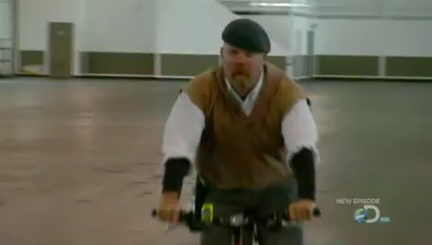
01-08 Projectile Motion
Notes:
Watch MythBusters bullet drop video

Slide 87


01-08 Projectile Motion
A batter hits a ball at 35° with a velocity of 32 m/s. How high did the ball go?
x: $v_{0x}=32\frac{m}{s}\cos{35°}=26.2\frac{m}{s}$
y: $y_{0y}=32\frac{m}{s}\sin{35°}=18.4\frac{m}{s},$
$a_{y}=−9.8\frac{m}{s^{2}}, y_{0}=0 m, y= ?,$
$v_{y}=0\frac{m}{s}$
y-direction:
$v_{y}^{2}=v_{0y}^{2}+2a_{y}\left(y−y_{0}\right)$
$0^{2}={\left(18.4\frac{m}{s}\right)}^{2}+2\left(−9.8\frac{m}{s^{2}}\right)\left(y−0\right)$
$0=338.9\frac{m^{s}}{s^{2}}−19.6\frac{m}{s^{2}}y$
$y=17 m$

Slide 88


01-08 Projectile Motion
How long was the ball in the air?
x: $v_{0x}=32\frac{m}{s}\cos{35°}=26.2\frac{m}{s}$
y: $y_{0y}=32\frac{m}{s}\sin{35°}=18.4\frac{m}{s},$
$a_{y}=−9.8\frac{m}{s^{2}}, y_{0}=0 m, y=0 m,$
$t= ?$
y-direction:
$y=\frac{1}{2}a_{y}t^{2}{+v_{0y}t+y}_{0}$
$0=\frac{1}{2}\left(−9.8\frac{m}{s^{2}}\right)t^{2}+\left(18.4\frac{m}{s}\right)t+0$
$0=t\left(−4.9\frac{m}{s^{2}}t+18.4\frac{m}{s}\right)$
$t=0 or t=3.8 s$

Slide 89



01-08 Projectile Motion
How far did the ball go?
x: $v_{0x}=32\frac{m}{s}\cos{35°}=26.2\frac{m}{s},$
$t=3.8 s, x= ?$
x-direction:
$x=x_{0}+v_{0x}t$
$x=0 m+26.2\frac{m}{s}\left(3.8 s\right)$
$x=98 m$
Or use the range equation
$$R=\frac{v_{0}^{2}\sin{2θ}}{g}$$
Where g is positive, $θ$ is the launch angle, and $y=y_{0}$

Slide 90
01-08 Homework
Project your answers onto your paper.

Slide 91

01-08b Projectile Motion Lab
IMPORTANT! The marble must never leave the desk when taking data.
Make a gentle ramp using your ruler and a book.
Roll the marble down the ramp several times to determine the average speed it will have when it rolls off the desk. (We did this in a previous lab.)
Take measurements to calculate the time until the marble hits the floor.
Using the average speed and time of free fall, calculate the landing spot for your marble from directly below the edge of your desk.
Place the target at the calculated location.
Call over the teacher.
When the teacher is watching, roll the marble down the ramp and see where it lands. The target gives your grade.
Grade = __________________________

